Slide 1
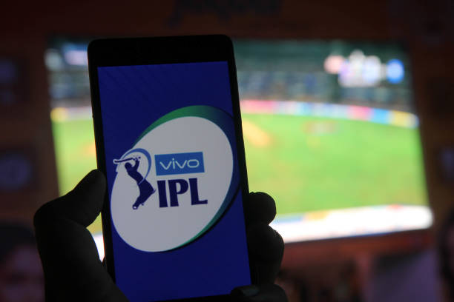
IPL Match Winner Prediction Using Machine Learning
Sakthi Aravind K
DA&DS
MAY2025

Slide 2

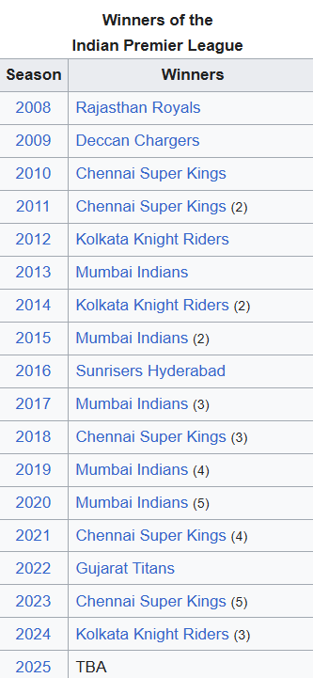
Introduction
The Indian Premier League (IPL) is one of the world's most popular cricket leagues.
This project uses historical IPL data to build a machine learning model to predict match outcomes.

Slide 3

Project Objective
To predict the winner of an IPL match using machine learning
Compare performance of models like Logistic Regression, SVM, KNN, Decision Tree, Random Forest, and XGBoost.
Select the best model based on accuracy and other metrics.

Slide 4

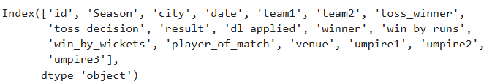
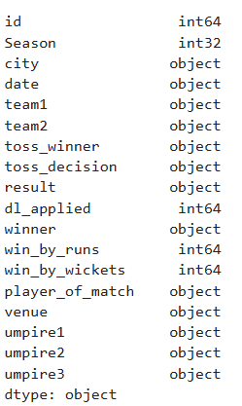

Dataset Overview
Dataset includes details of IPL matches from 2008 to recent seasons
Key columns:
Teams, Venue, Toss Result
Match Winner, Win Margin
Player of the Match, Umpires

Slide 5

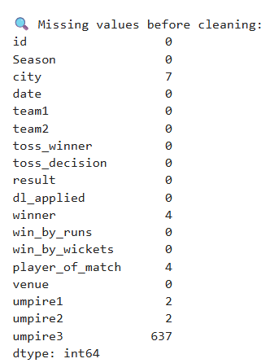
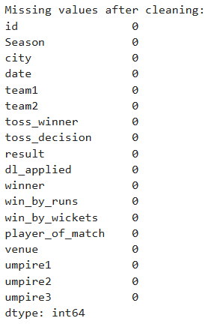
Data Cleaning & Preprocessing
Handled missing values and removed inconsistencies.
Categorical variables encoded using Label Encoding.
Features scaled using StandardScaler.
Split into training and testing datasets.

Slide 6

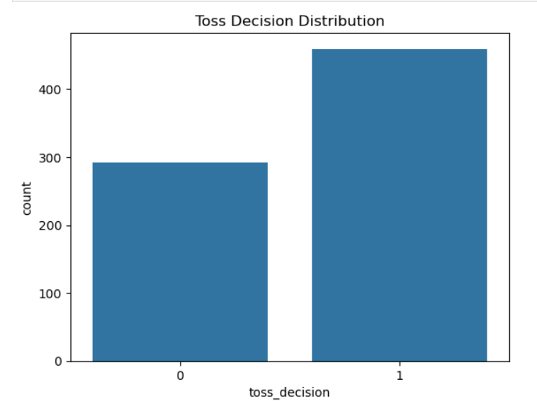
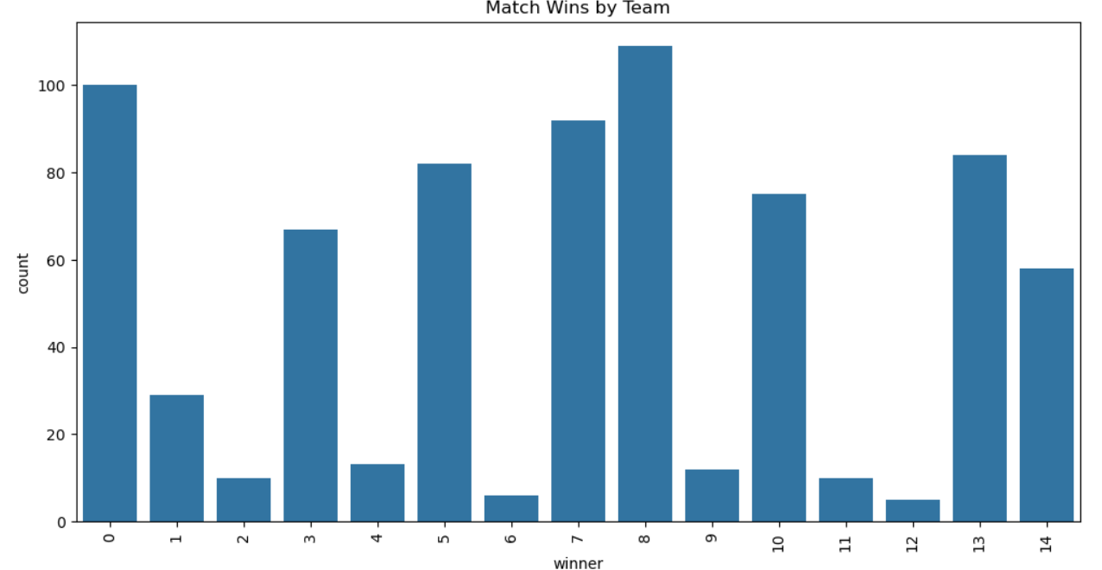
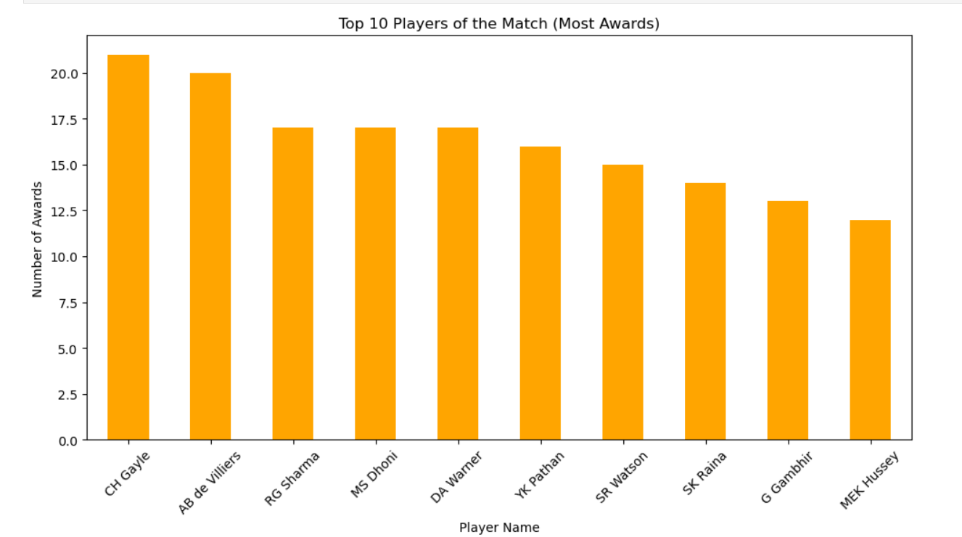
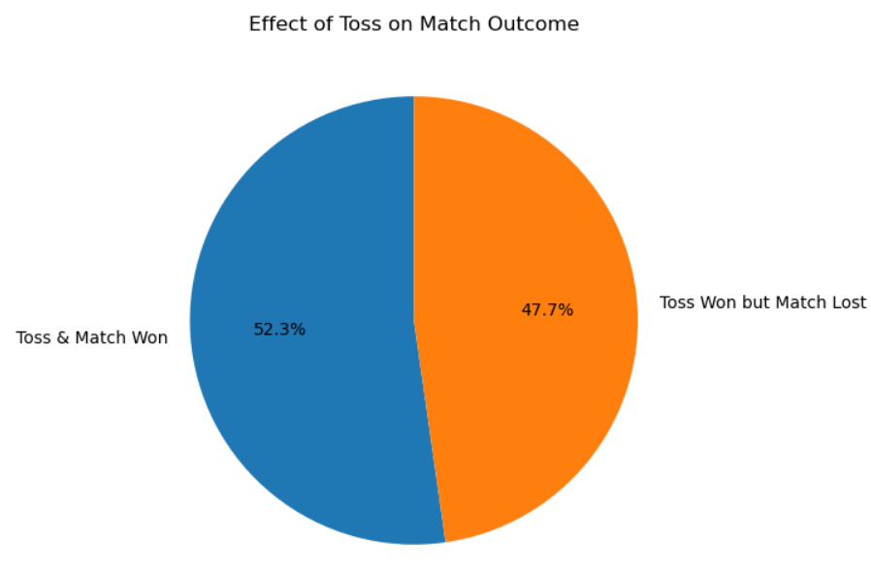
Exploratory Data Analysis (EDA)

Slide 7


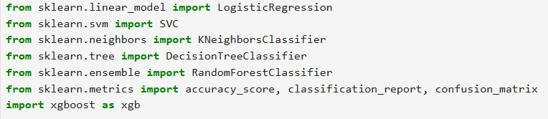
Machine Learning Models Used
Logistic Regression
Support Vector Machine (SVM)
K-Nearest Neighbors (KNN)
Decision Tree
Random Forest
XGBoost

Slide 8

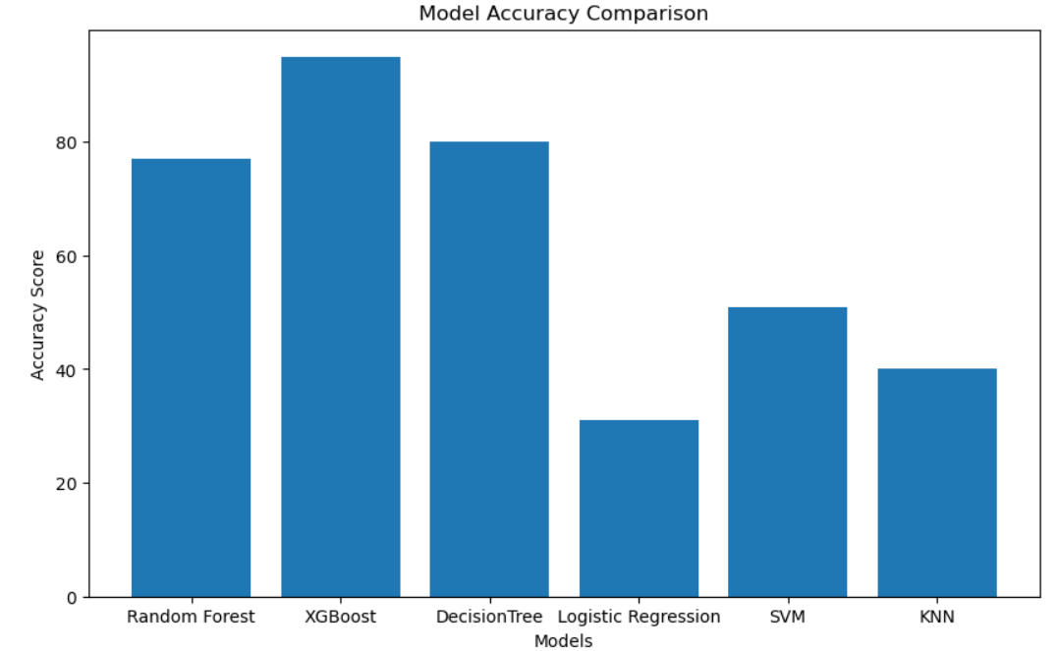
Accuracy Comparison
Logistic Regression:31 %
SVM: 51%
KNN: 40%
Decision Tree: 80%
Random Forest: 75%
XGBoost: 95%

Slide 9


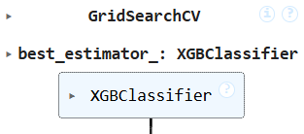
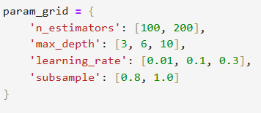
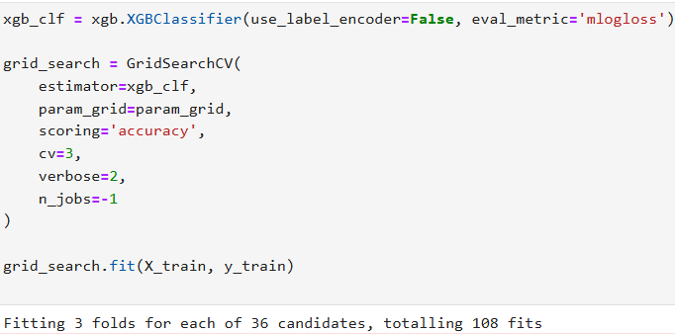

Hyperparameter Tuning

Slide 10

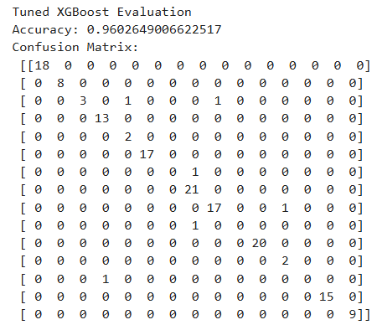
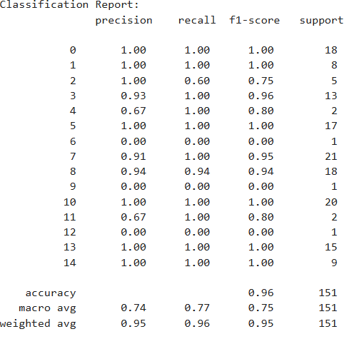
Final Model Evaluation
XGBoost chosen as the final model based on highest performance.
Evaluation metrics:
Accuracy
Precision
Recall
F1 Score

Slide 11

Conclusion & Future Work
XGBoost provided best accuracy.
Future Improvements:
Add player-level data
Use live data (weather, pitch)
Desplay as web or mobile app

Slide 12

Thank You

